Slide 1
Preliminary RP results
Helmut Vincke
on behalf of RP

Slide 2
Contents:
First results on radiation levels seen at Point 6 during the test
First results on radiation levels seen at Point 5 during the test
Consequences for CMS?
Survey and access to the LHC after the test

Slide 3
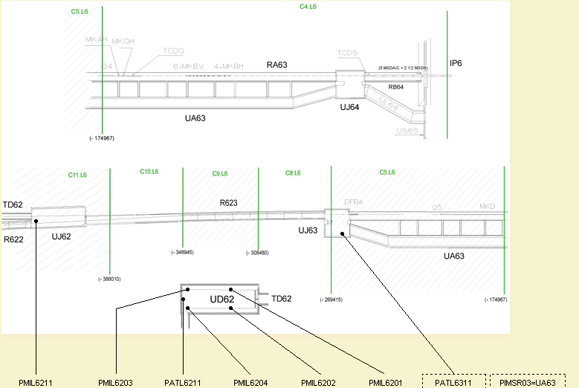
Radiation levels at Point 6 during beam to the dump
PMI6314

Slide 4
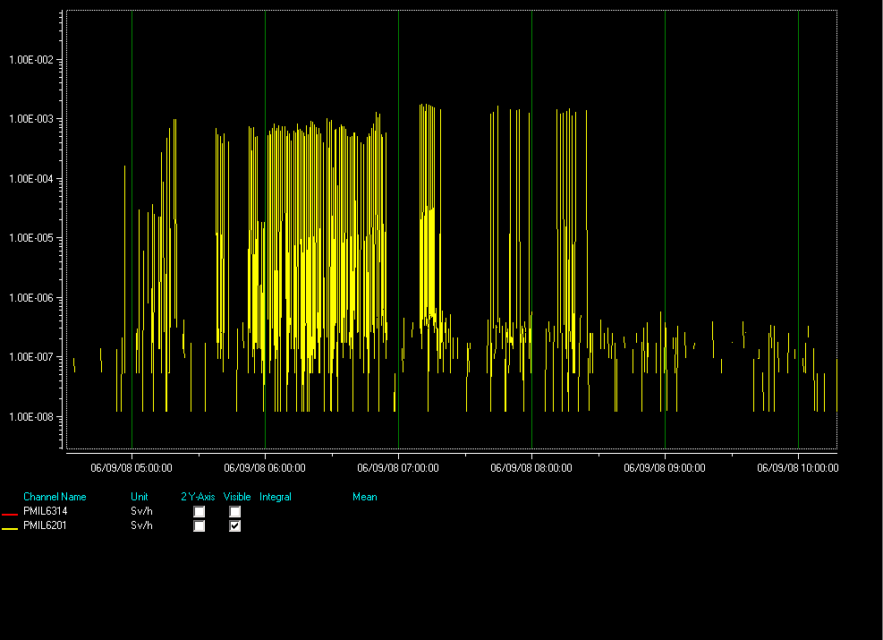
Radiation levels at the dump

Slide 5
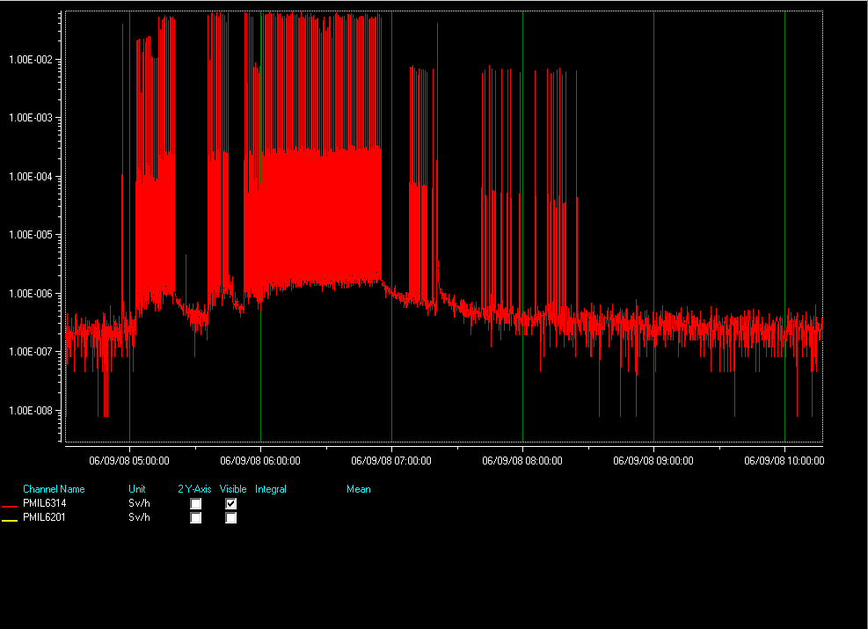
Radiation levels at TCDQ

Slide 6
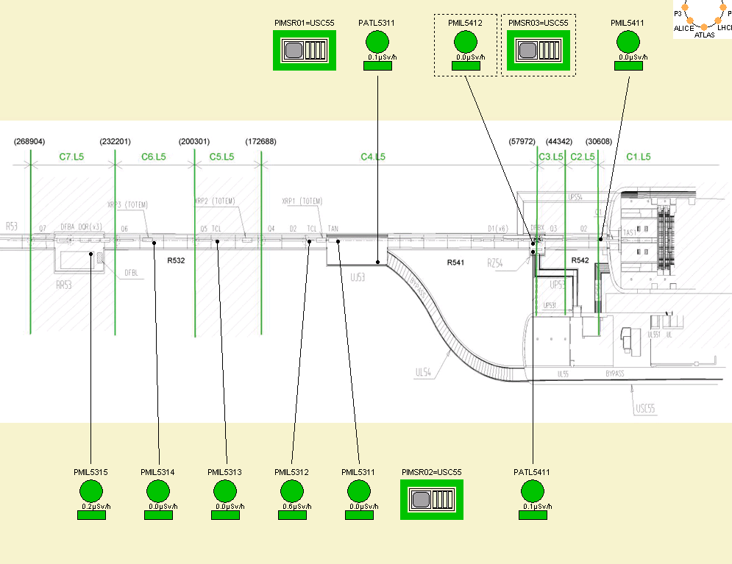
Radiation levels at Point 5 during the beam operation

Slide 7
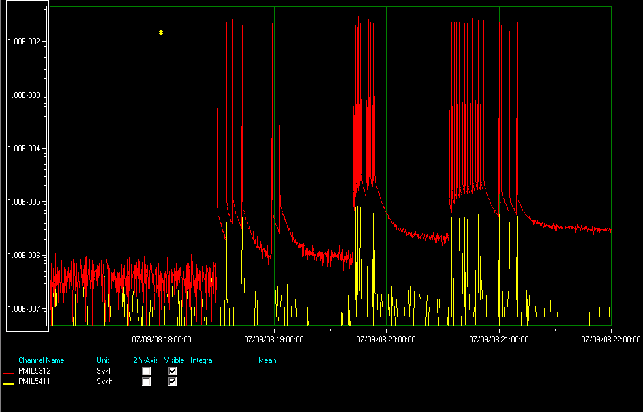

Slide 8
Results and consequences from “Radiation Survey” close to CMS cavern
In order to keep the classification “non-designated” in the CMS cavern radiation measurements were carried out in after the test.
The radiation levels around the collimator (beam impact point in R532) were in the range of 100 uSv/h.
The radiation level close to the CMS cavern (area R542) was found at natural radiation background level. ➔ CMS cavern could remained “non designated” for the 8th and 9th of September.

Slide 9
Accesses and Radiation Survey after the test
Due to lack of time (2 days to LHC start) no radiation survey could be carried out.
All accesses to area which have seen beam were accompanied by RP personnel.
General comment to access requests: Please group the accesses according their location in the LHC via the 8:30 meeting.

